Slide 1
Predicting Traffic Congestion
By: Muhammad Akbar & Trent Wydrowski

Slide 2
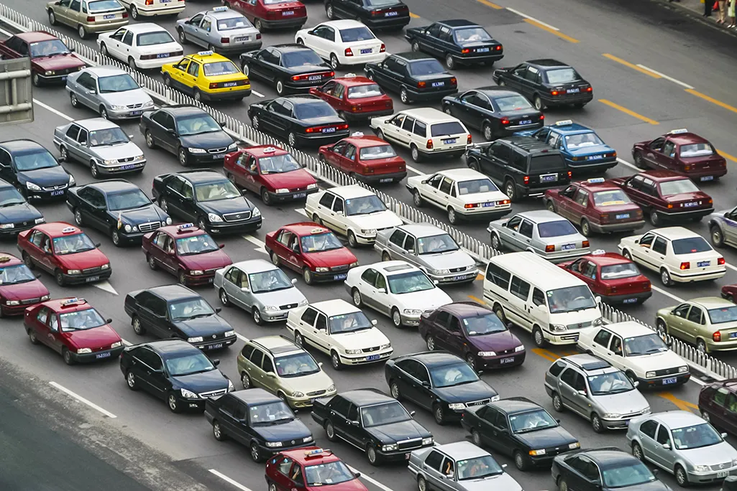
Motivation
Traffic has negative impacts in:
Lost time,
Wasted fuel,
Increase cost of transporting goods
Our primary motivation is to see if we can analyze traffic congestion to uncover insights to support traffic predictions

Slide 3

Objective
Our objective is to build a model using Random Forest Regressor to predict traffic patterns. This allows us to apply ML concepts we have learned from class to help predict traffic flow. We can interpret these results to offer insights about the data and validate if RF would be a viable forecasting method for this data.

Slide 4
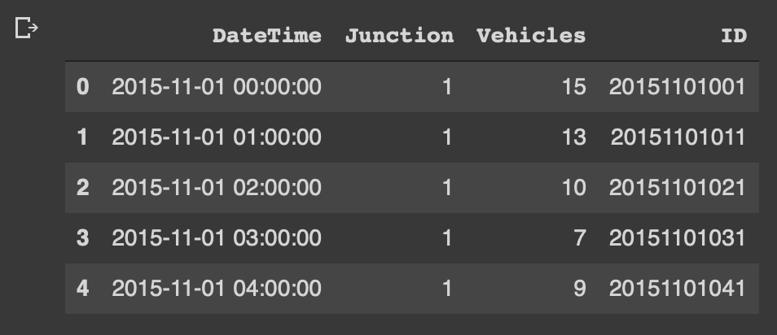
Data Description
Default Data Attributes:
ID (pk)
Datetime
Junction
Vehicles

Slide 5
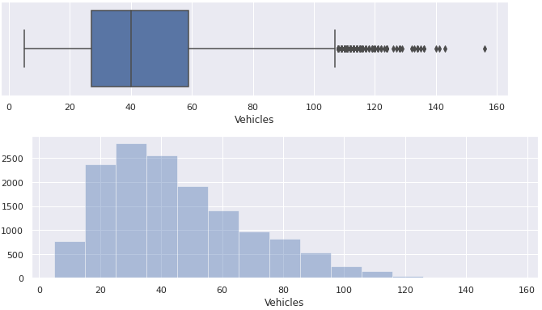
Approach
Data Cleaning:
Check for Structural errors - None
Check for Nulls - None
Check for Duplicates - None
Plotted Vehicle Count Distributions - Domain Knowledge

Slide 6
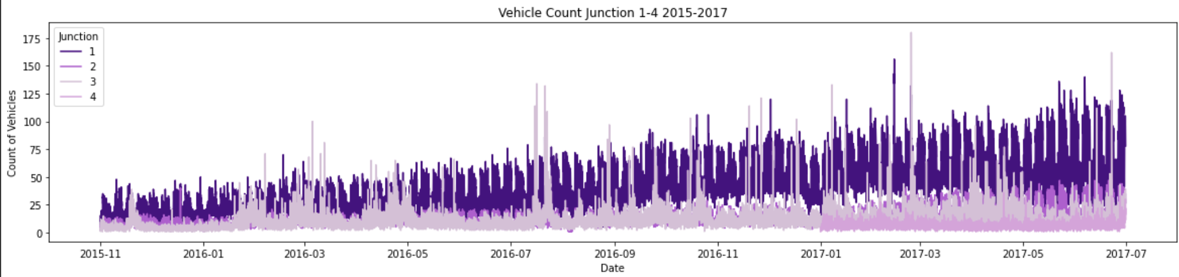
Approach
Exploratory Data Analysis
Plot time series 2015-2017
See Junction 1-4

Slide 7
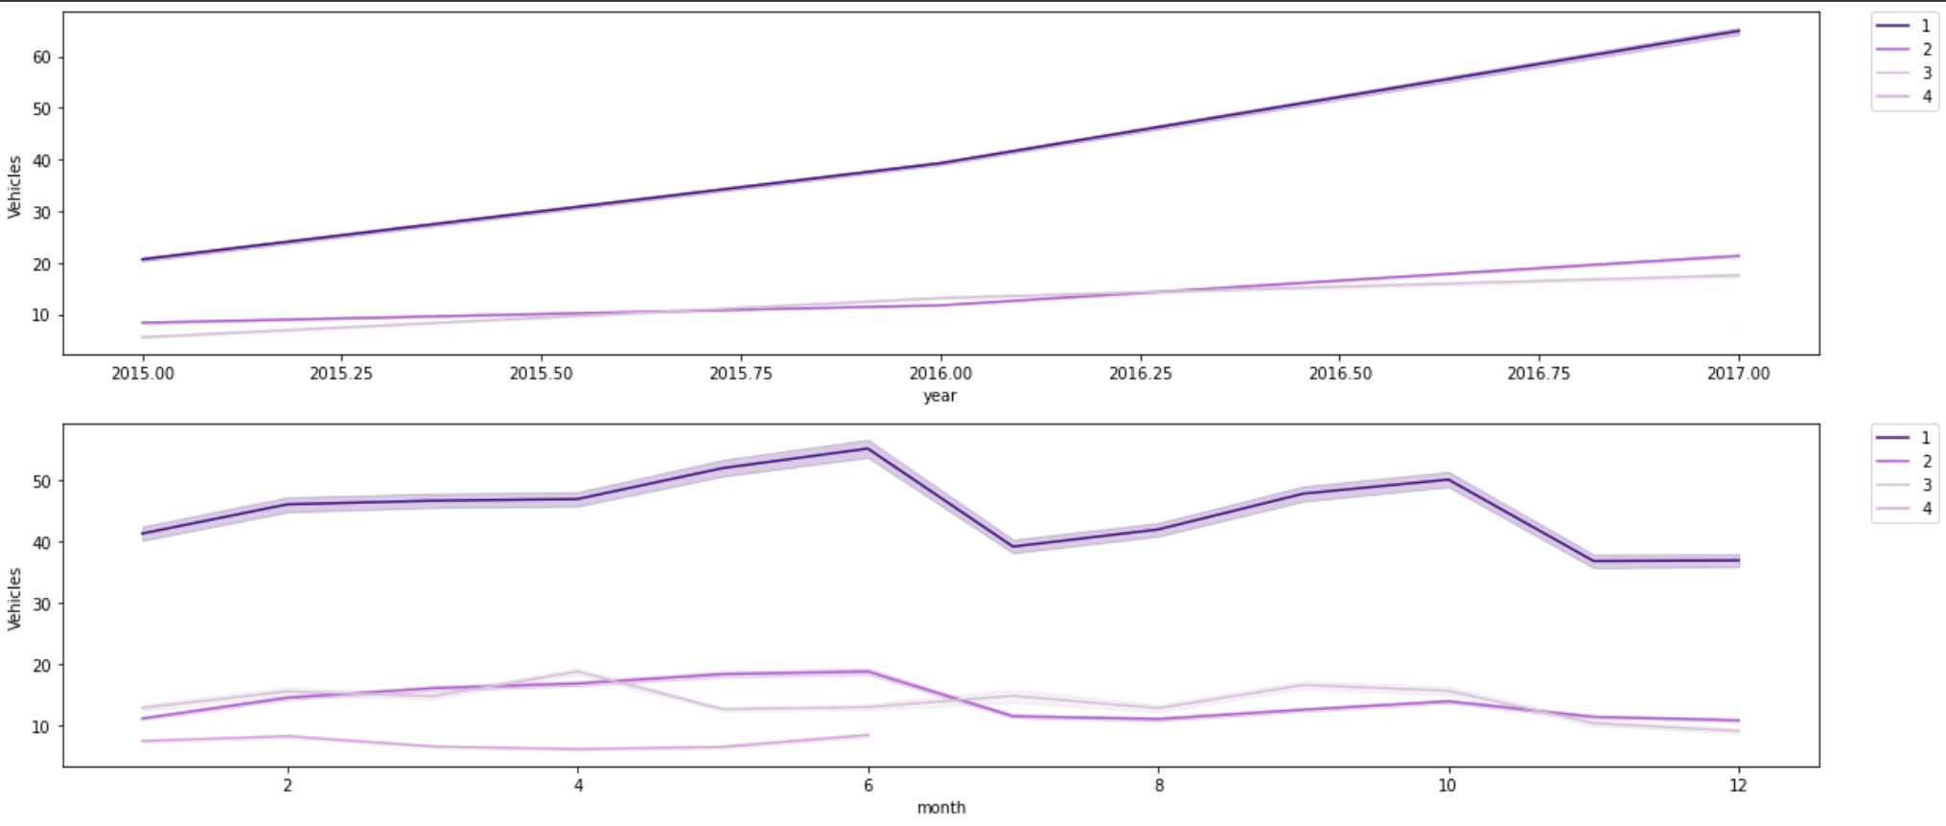
Approach
Exploratory Data Analysis - Feature Engineer

Slide 8
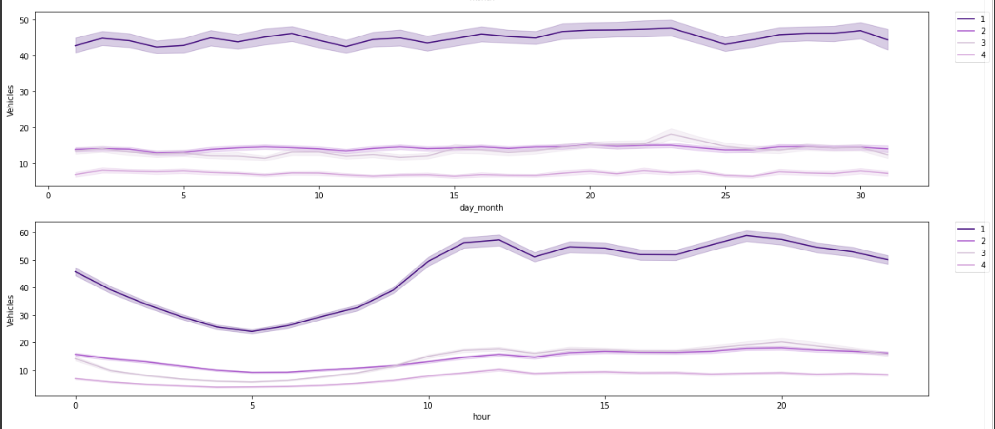
Approach
Exploratory Data Analysis - Feature Engineer

Slide 9
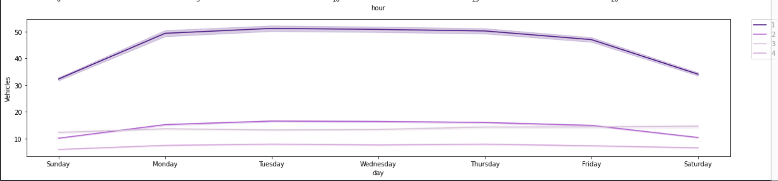
Approach
Exploratory Data Analysis - Feature Engineer

Slide 10
Approach
Create model for time series forecasting by utilizing Random Forest in Python for Junction 1
Train/test split
Utilized RandomForestRegressor (1000 decision trees)
Calculate Mean Absolute Error & Accuracy
Establish Feature Importance
Creating plot predictions for analysis and interpretation

Slide 11
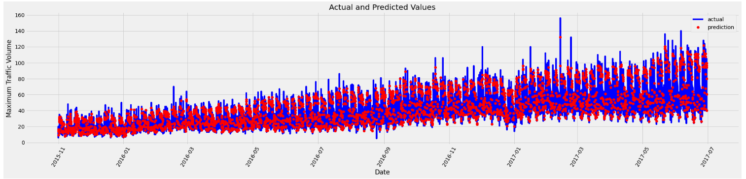
Results (cont.)

Slide 12

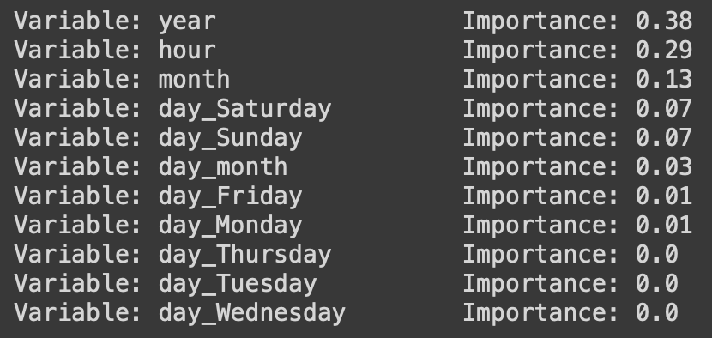
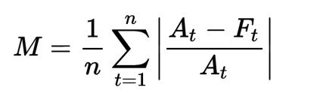
Results (cont.)
Mean Absolute Error = 2.89
Mean Absolute Percentage Error = 92.37%

Slide 13
Conclusion
Using Random Forest Regressor as a Prediction Model proved accurate considering accuracy metrics + visual check
Useful for forecasting future traffic conditions
Feature extraction from DateTime allowed for interesting analysis
Increasing trends, weekly cycle, daily cycle, annual patterns

Slide 14
References
https://www.kaggle.com/datasets/fedesoriano/traffic-prediction-dataset?resource=download
https://towardsdatascience.com/random-forest-in-python-24d0893d51c0

Slide 15
Questions?

